Slide 1
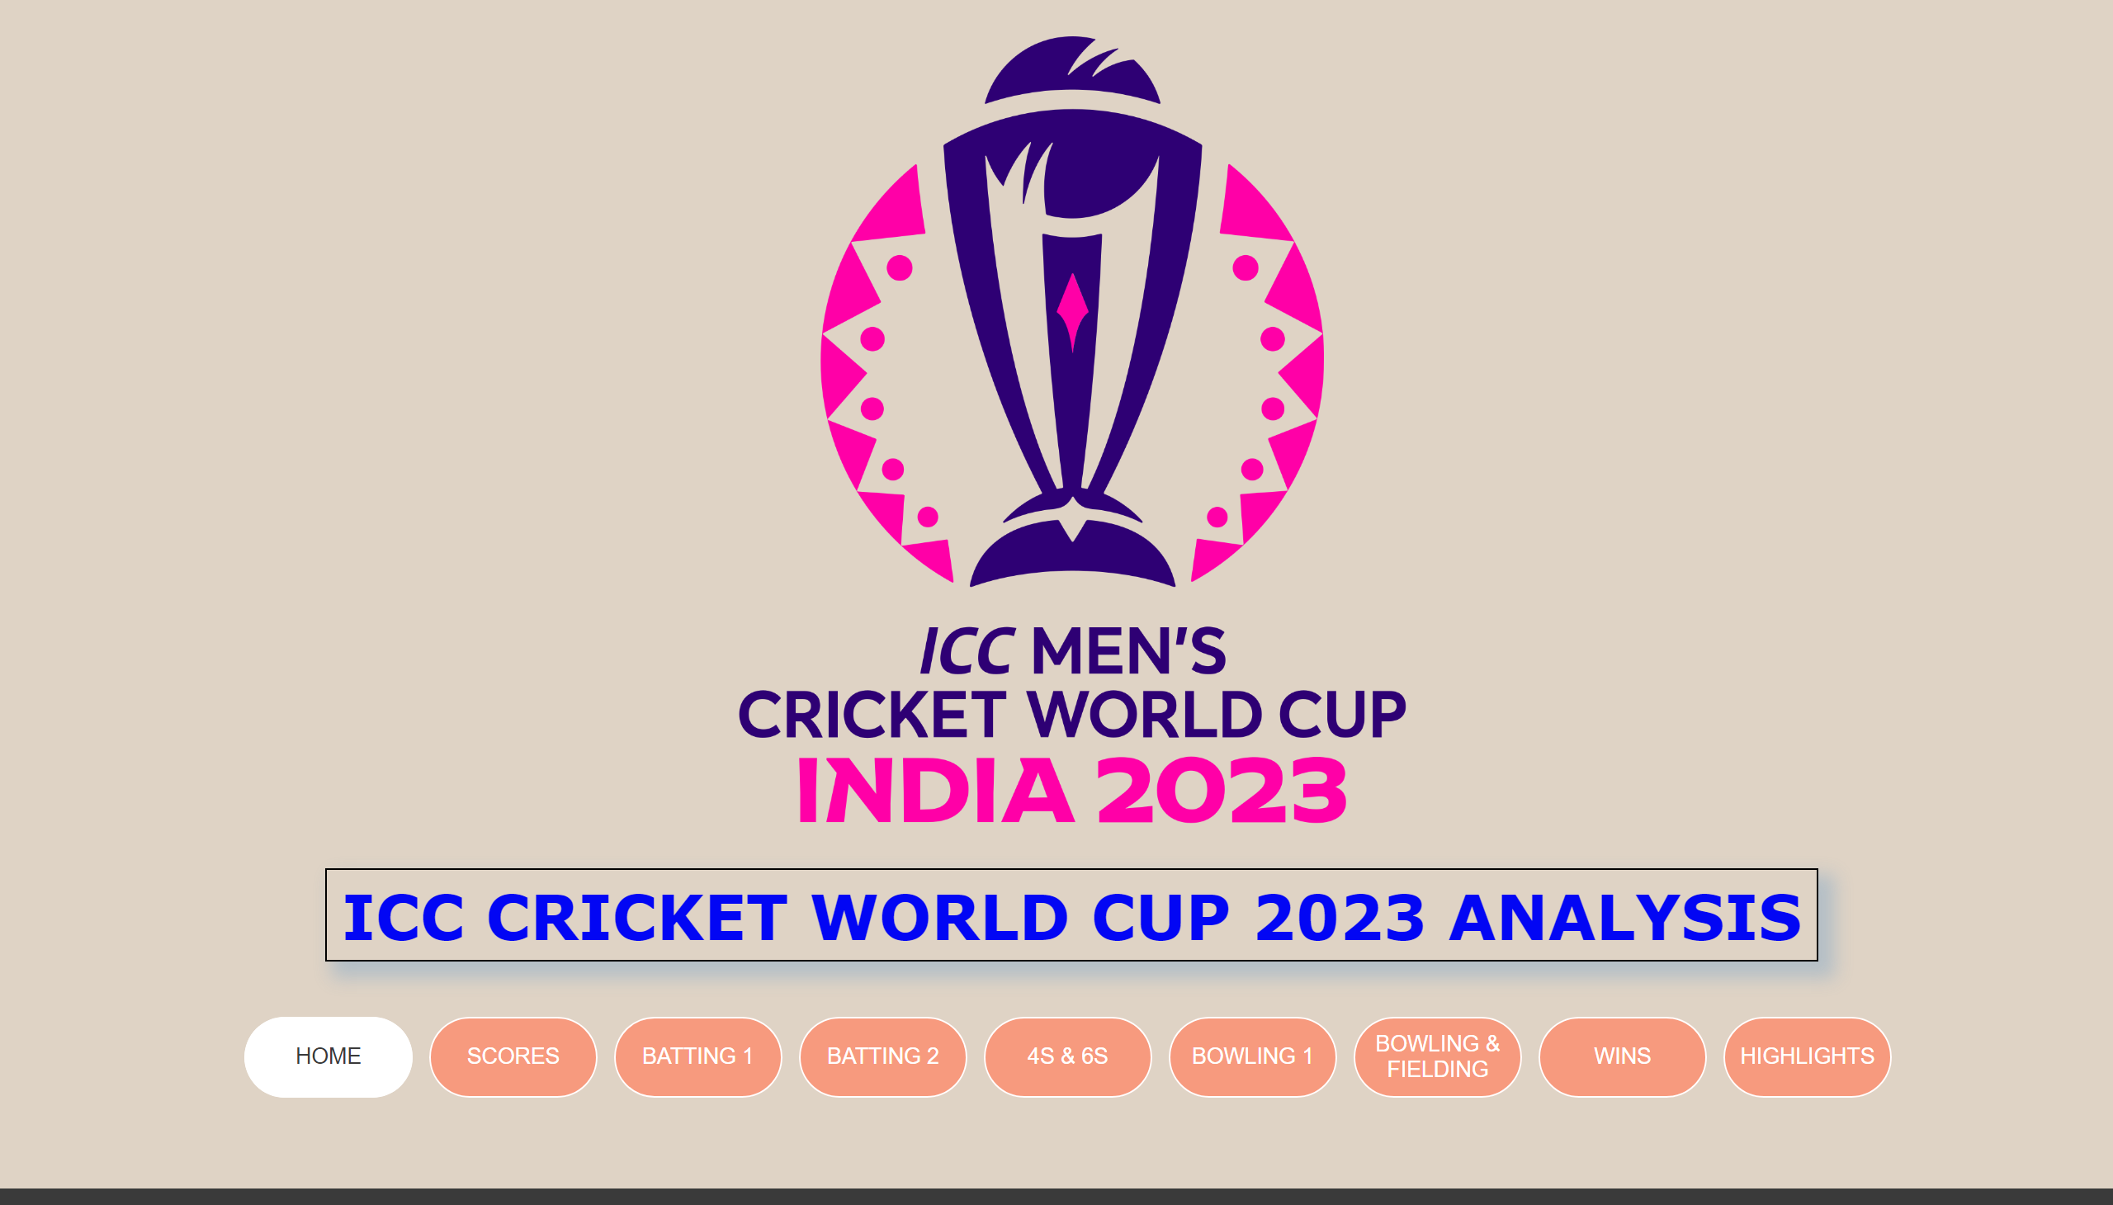
HOME
Created By Sakthivel Tamilselvan
Notes:
pageNavigator
No alt text provided
image
No alt text provided
textbox
No alt text provided

Slide 2
Table of Content
*Team Scores
*Most runs & Average
*Individual Performance
*4s & 6s By Teams and Individual
*Best Bowling Performance
*Bowling and Catches
*Wins
*Highlights

Slide 3
The 2023 ICC Men's Cricket World Cup was the 13th edition of the Cricket World Cup, a quadrennial One Day International (ODI) cricket tournament organized by the International Cricket Council (ICC).
It was hosted from 5 October to 19 November 2023 across ten venues in India. This was the fourth World Cup held in India, but the first where India was the sole host.
The tournament was contested by ten national teams, maintaining the same format used in 2019.
After six weeks of round-robin matches, India, South Africa, Australia, and New Zealand finished as the top four and qualified for the knockout stage.
In the knockout stage, India and Australia beat New Zealand and South Africa, respectively, to advance to the final, played on 19 November at the Narendra Modi Stadium in Ahmedabad. Australia won the final by six wickets, winning their sixth Cricket World Cup title.

Slide 4
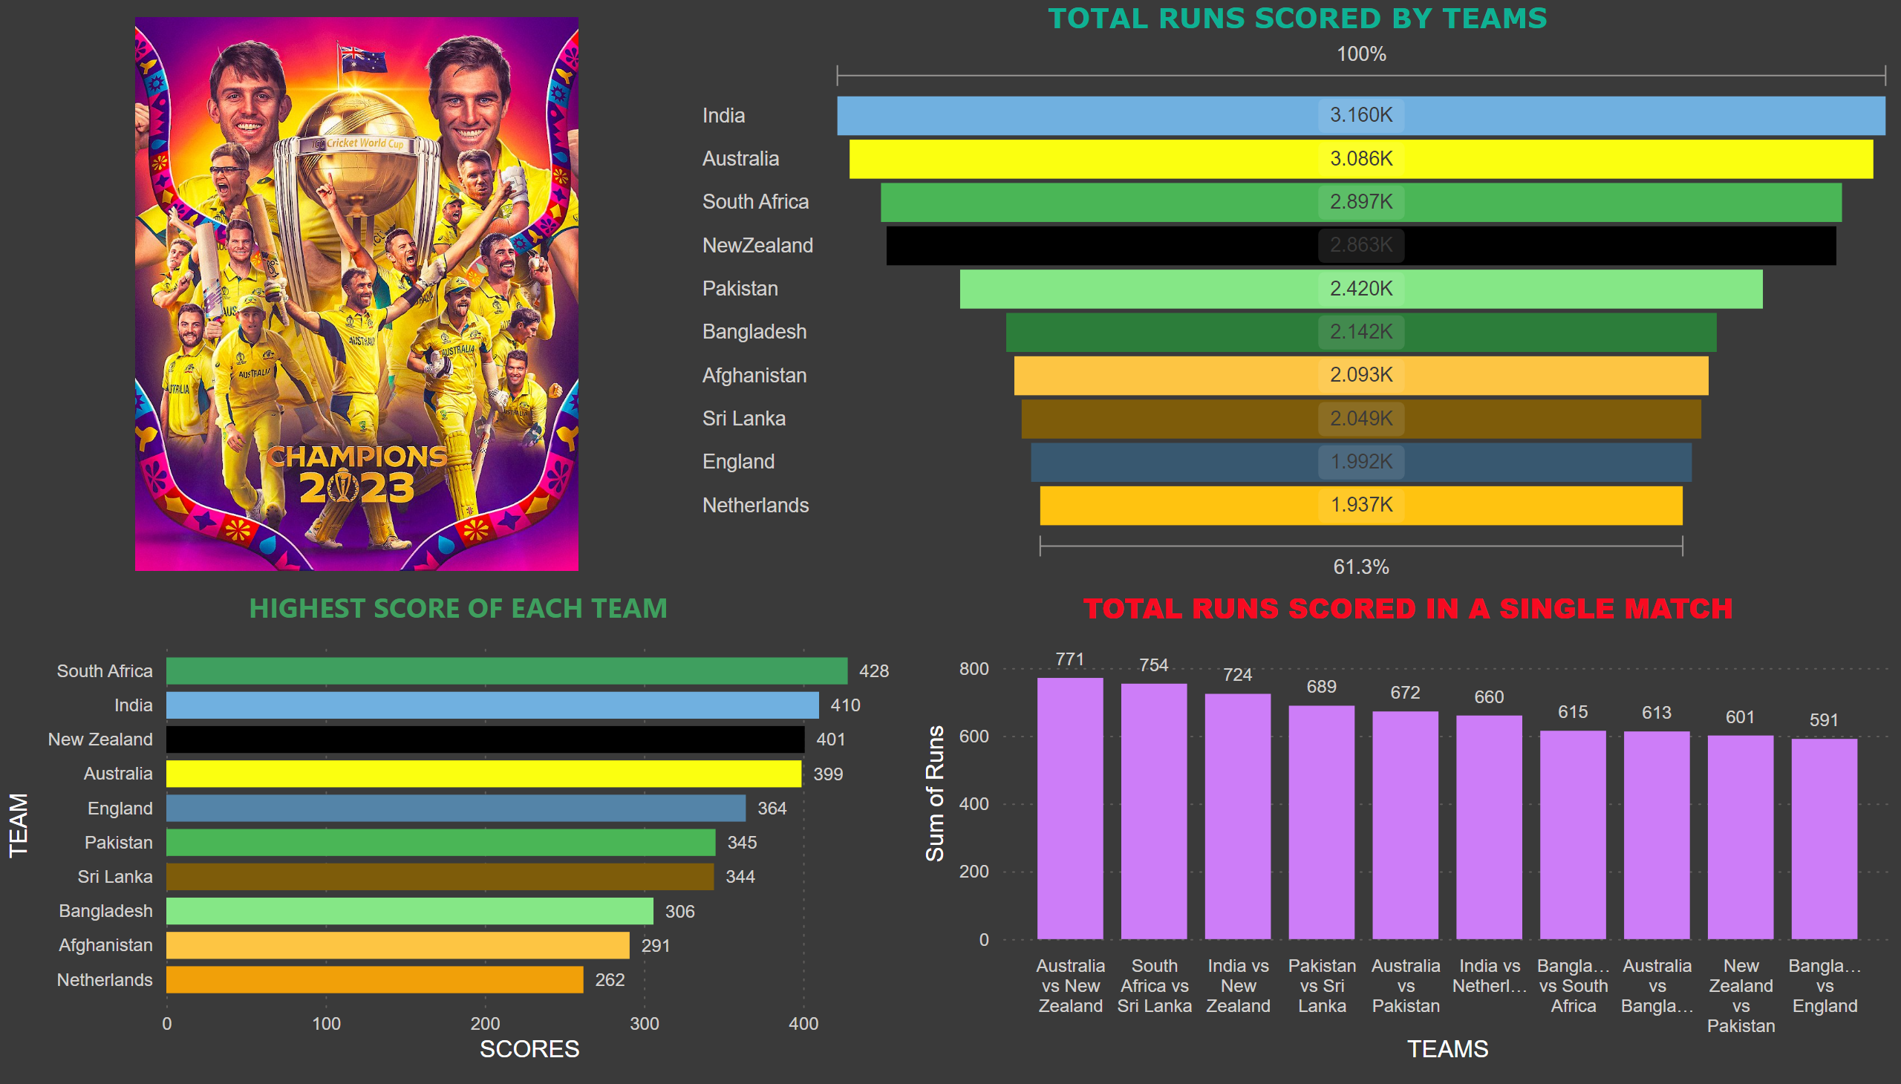
SCORES
Notes:
TOTAL RUNS SCORED IN A SINGLE MATCH
No alt text provided
TOTAL RUNS SCORED BY TEAMS
No alt text provided
HIGHEST SCORE OF EACH TEAM
No alt text provided
image
No alt text provided

Slide 5
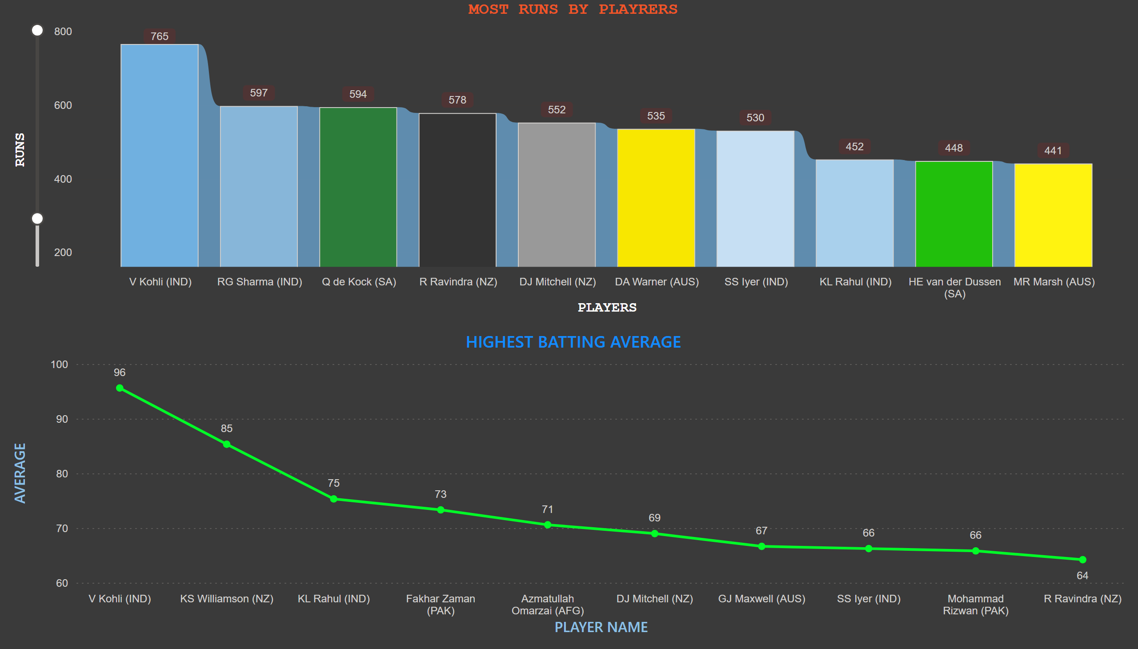
BATTING 1
Notes:
MOST RUNS BY PLAYRERS
No alt text provided
HIGHEST BATTING AVERAGE
No alt text provided

Slide 6
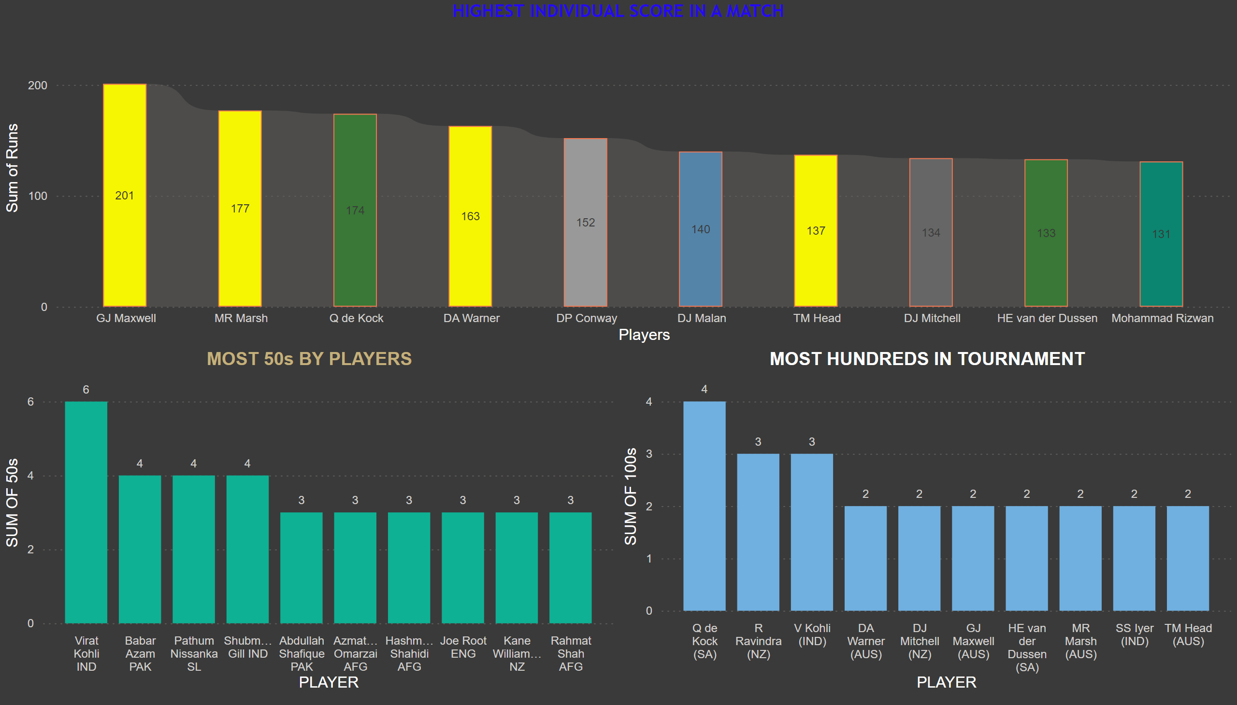
BATTING 2
Notes:
MOST HUNDREDS IN TOURNAMENT
No alt text provided
actionButton
No alt text provided
HIGHEST INDIVIDUAL SCORE IN A MATCH
No alt text provided
MOST 50s BY PLAYERS
No alt text provided

Slide 7
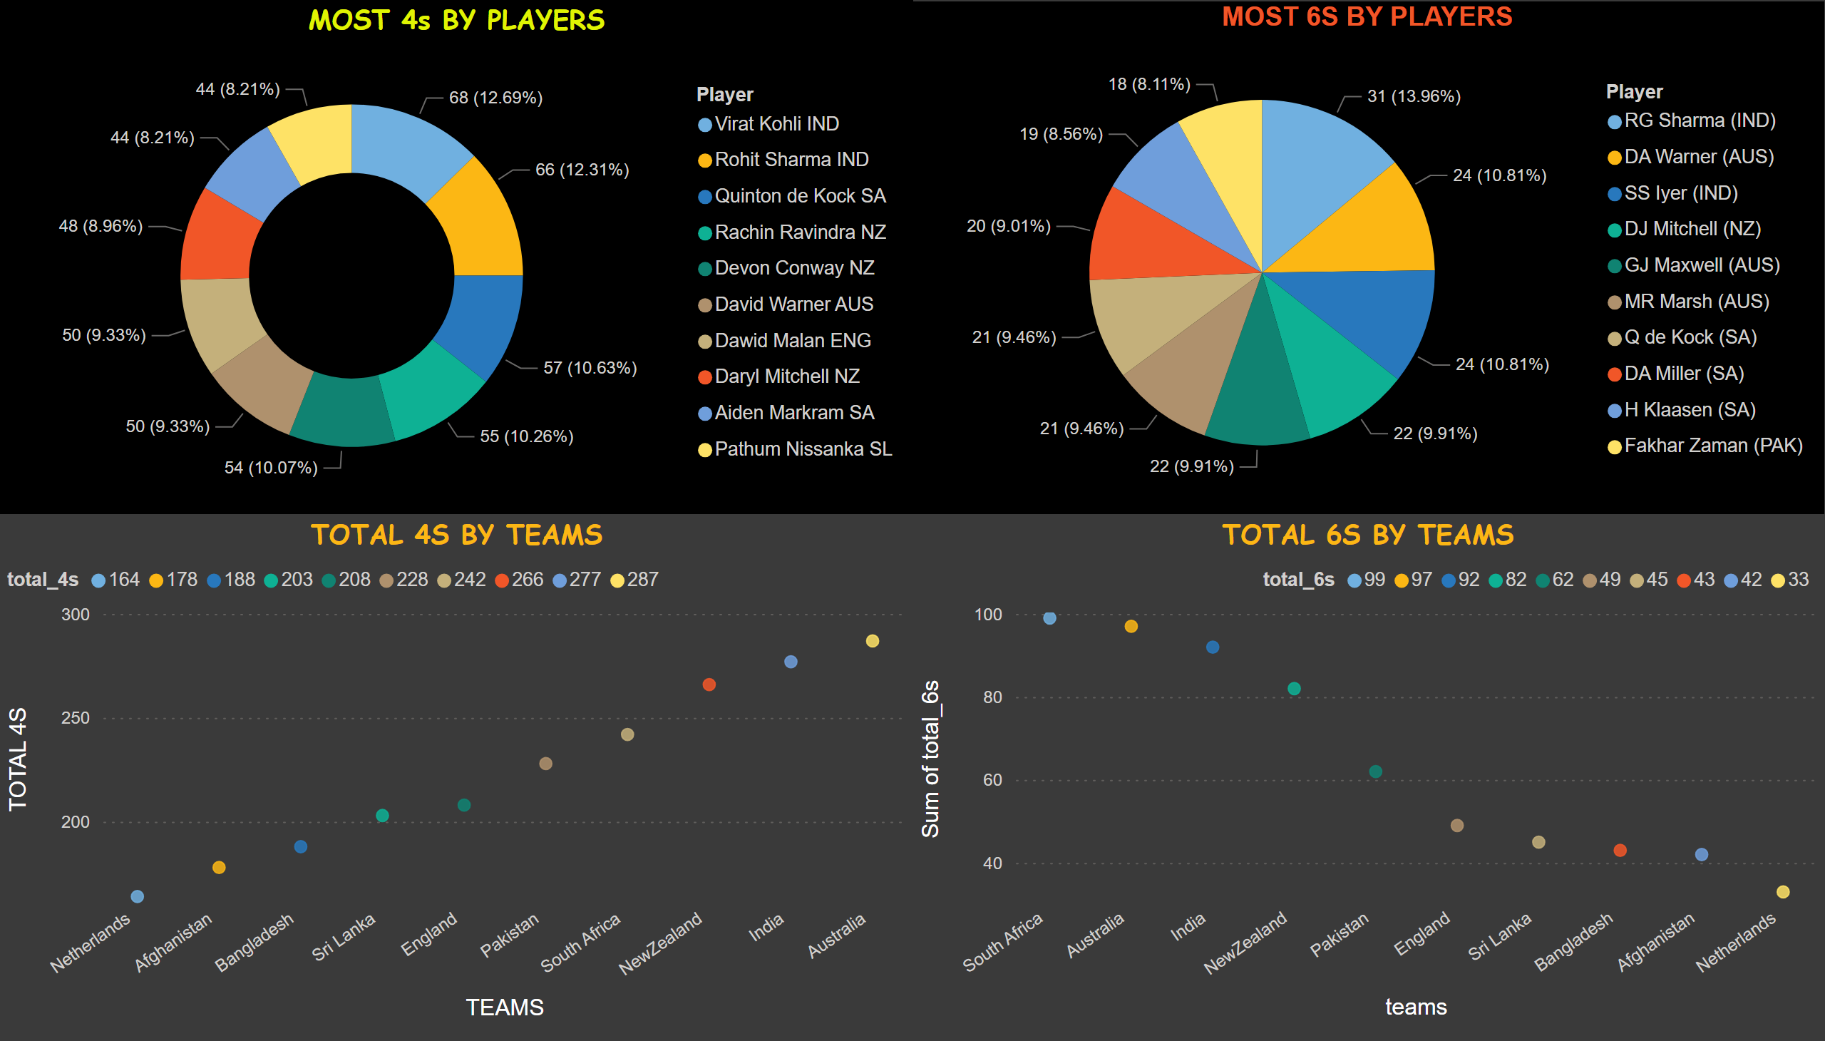
4S & 6S
Notes:
MOST 4s BY PLAYERS
No alt text provided
MOST 6S BY PLAYERS
No alt text provided
TOTAL 4S BY TEAMS
No alt text provided
TOTAL 6S BY TEAMS
No alt text provided

Slide 8
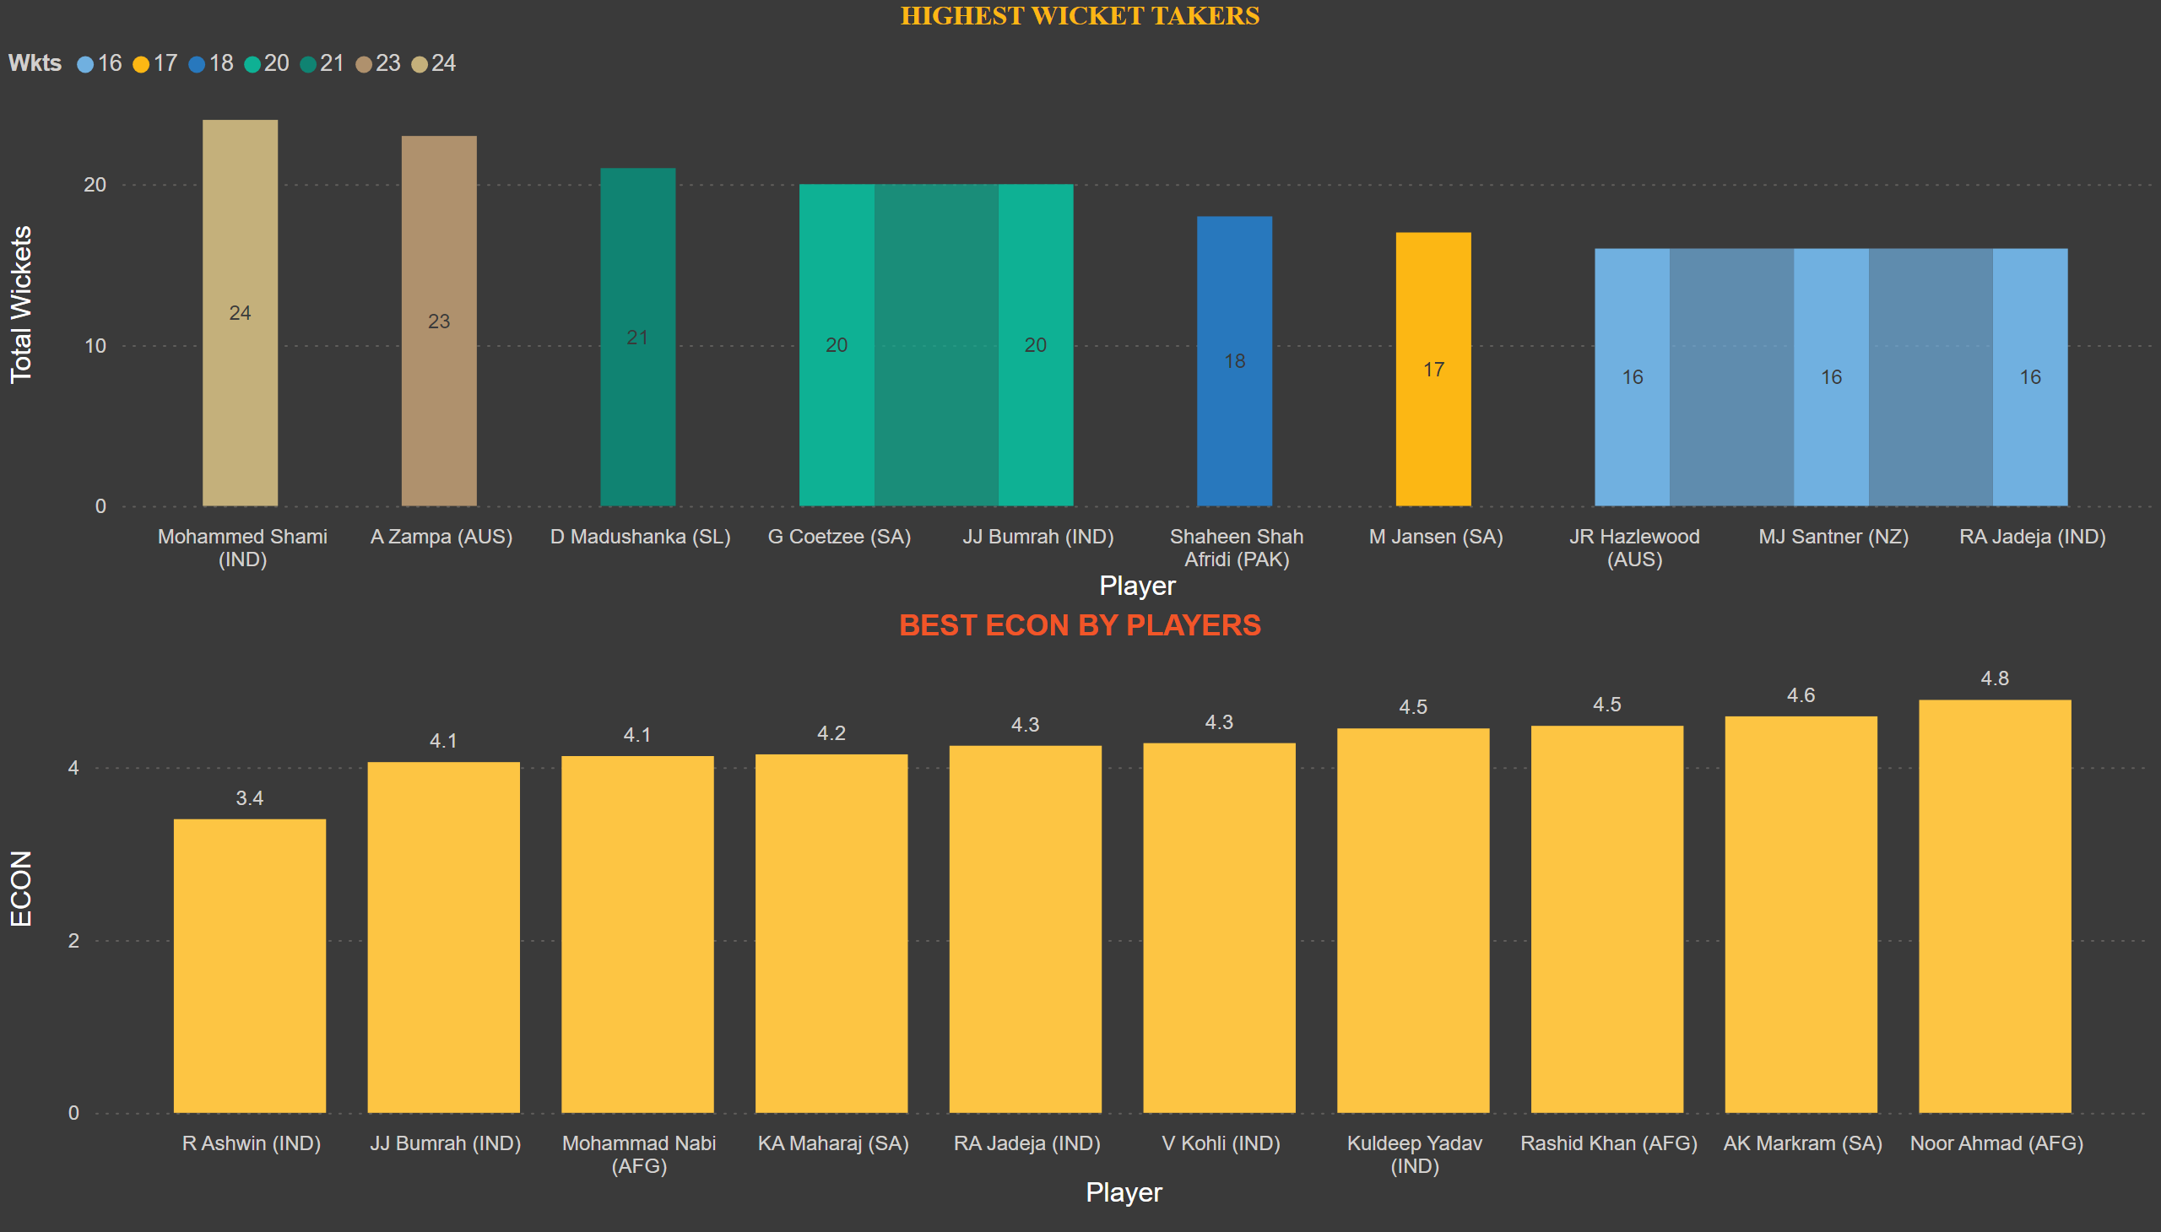
BOWLING 1
Notes:
HIGHEST WICKET TAKERS
No alt text provided
BEST ECON BY PLAYERS
No alt text provided

Slide 9
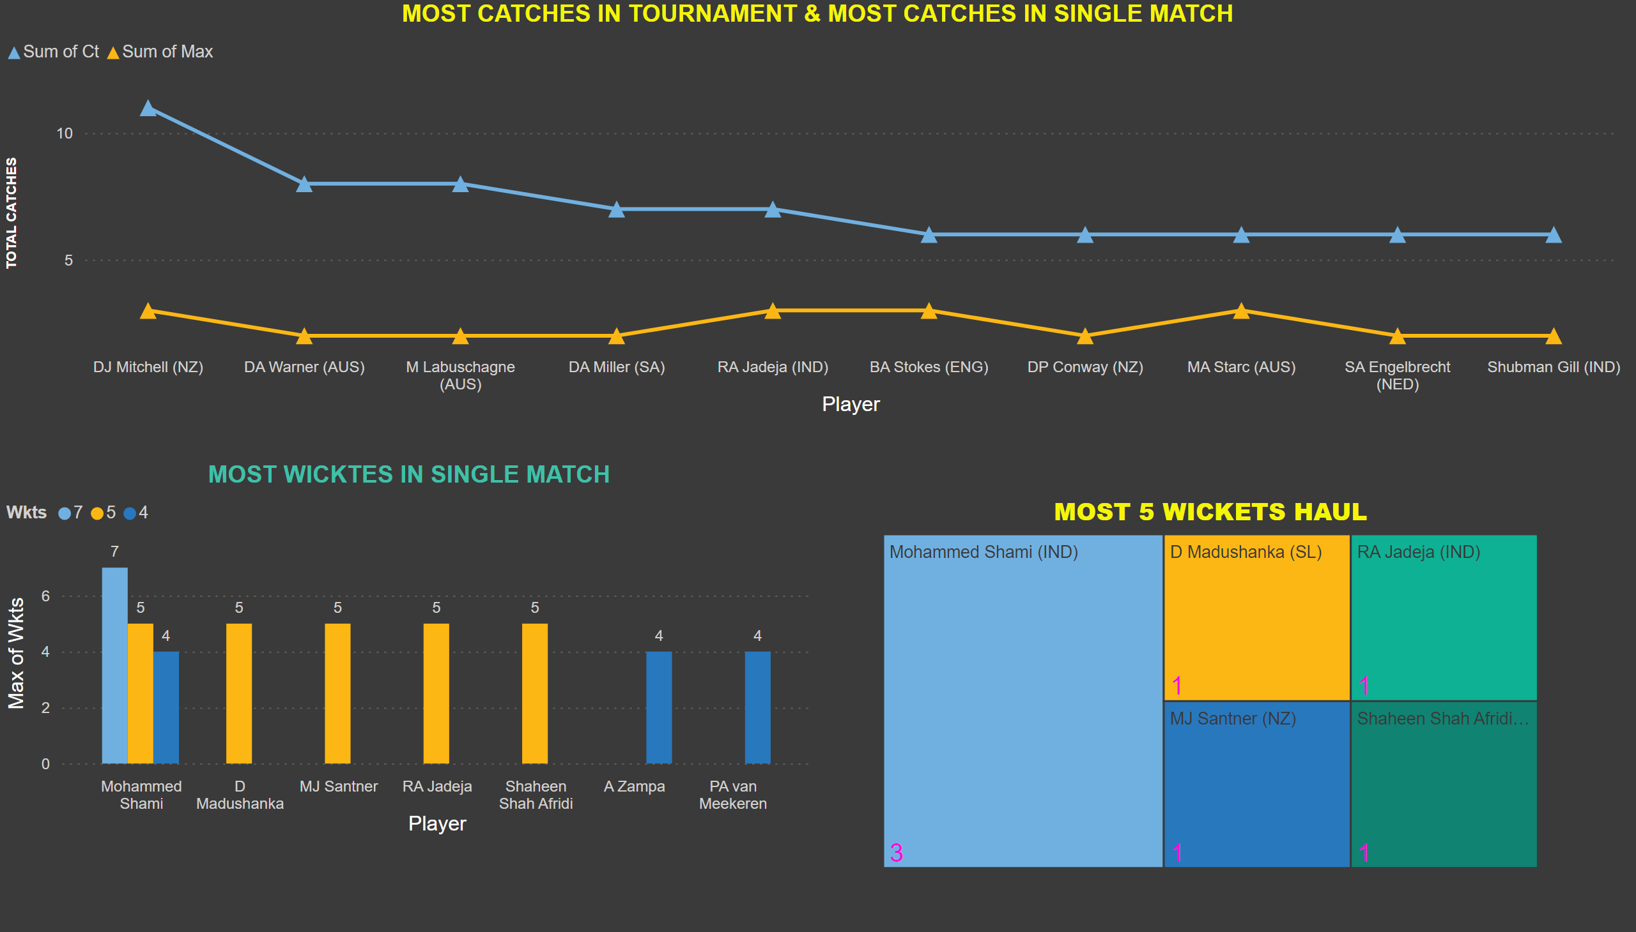
BOWLING & FIELDING
Notes:
MOST CATCHES IN TOURNAMENT & MOST CATCHES IN SINGLE MATCH
No alt text provided
MOST WICKTES IN SINGLE MATCH
No alt text provided
MOST 5 WICKETS HAUL
No alt text provided

Slide 10
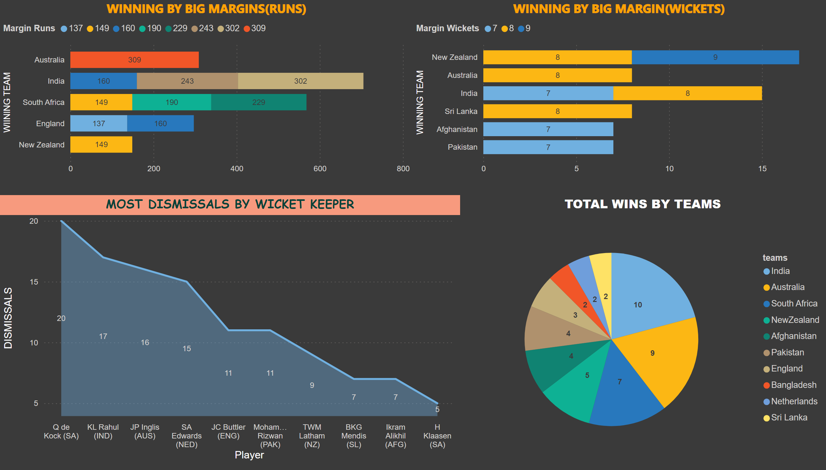
WINS
Notes:
WINNING BY BIG MARGINS(RUNS)
No alt text provided
WINNING BY BIG MARGIN(WICKETS)
No alt text provided
MOST DISMISSALS BY WICKET KEEPER
No alt text provided
TOTAL WINS BY TEAMS
No alt text provided

Slide 11
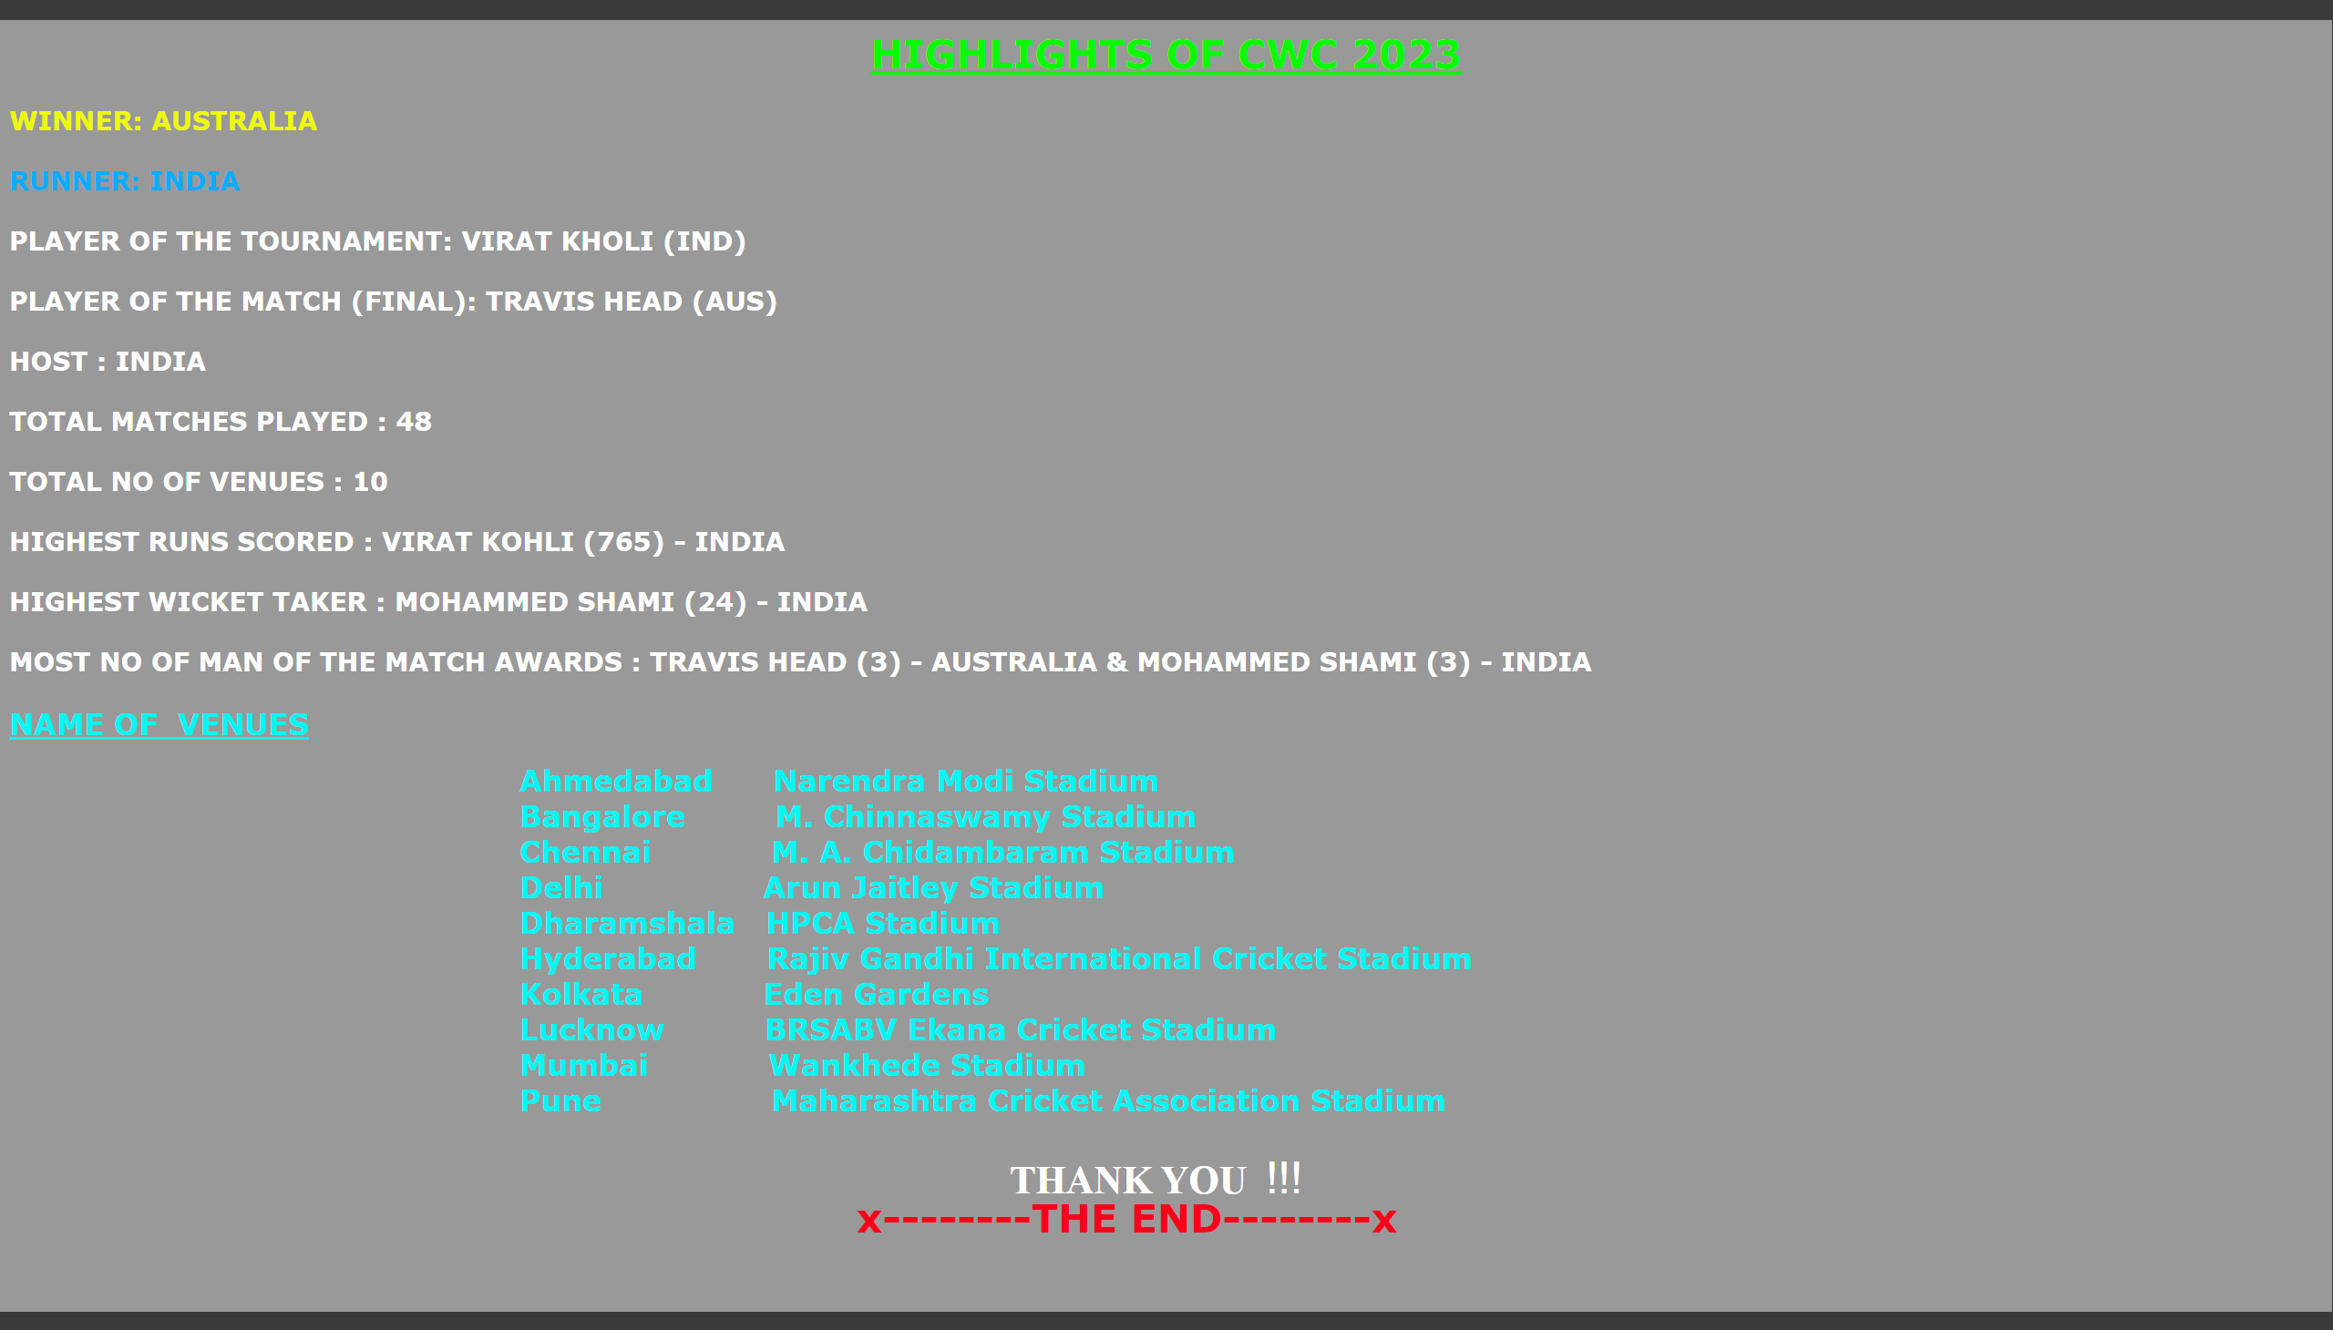
HIGHLIGHTS
Notes:
textbox
No alt text provided

